Slide 1


Manage and Use PT data
Brazilian Experience
Renata Cristina Messores Rudolf
Laboratory of Molecular Biology, Microbiology and Serology (LBMMS)

Slide 2
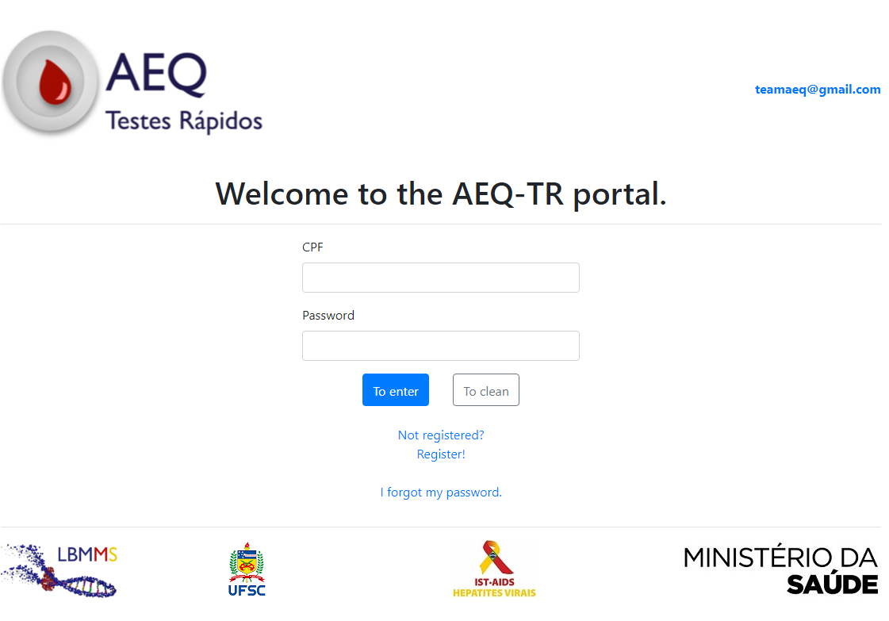
Manage and Use PT data
Practice rounds
Theoretical rounds

Slide 3
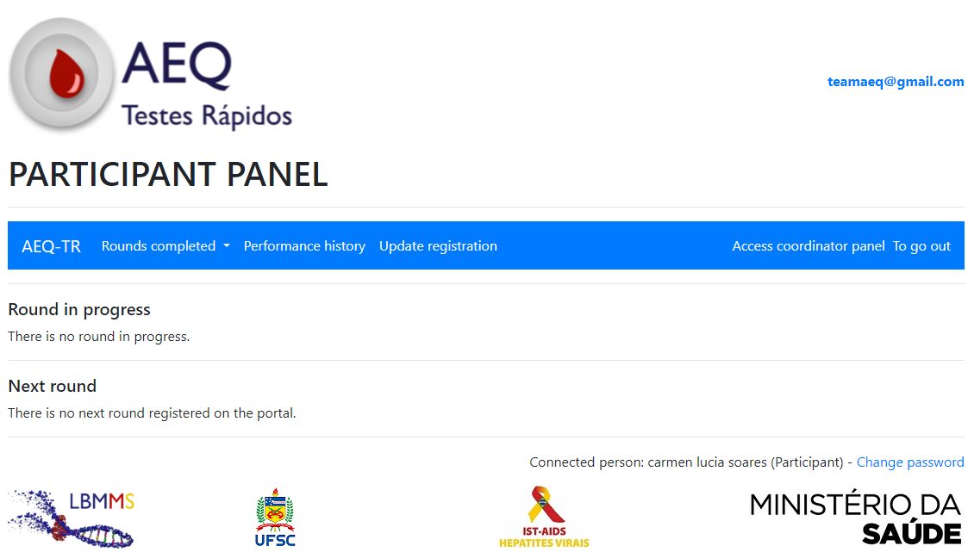
Manage and Use PT data
Name

Slide 4
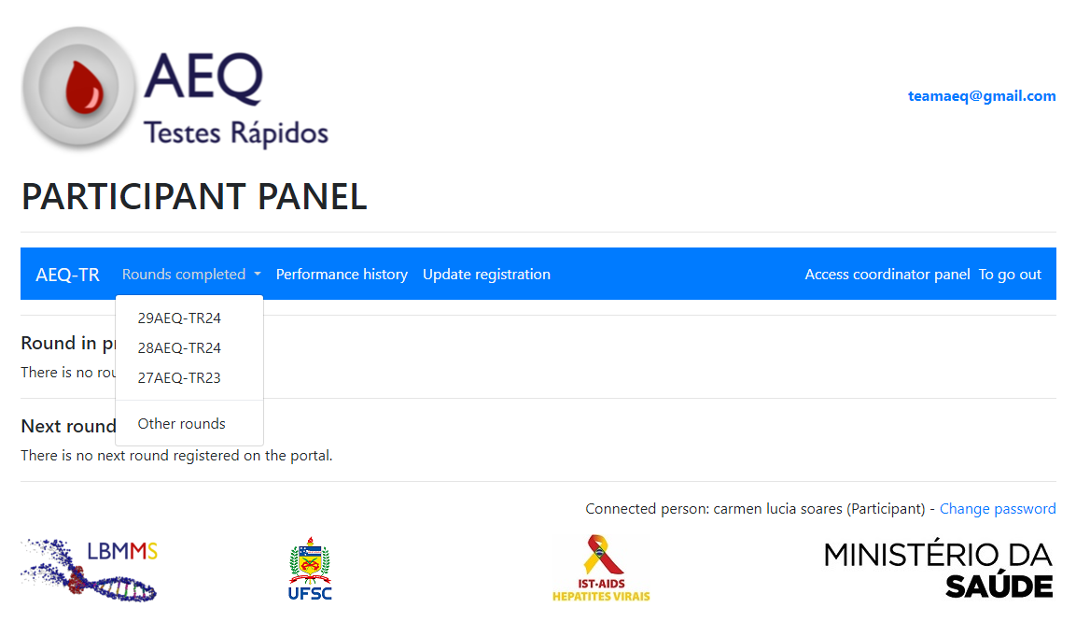
Manage and Use PT data

Slide 5
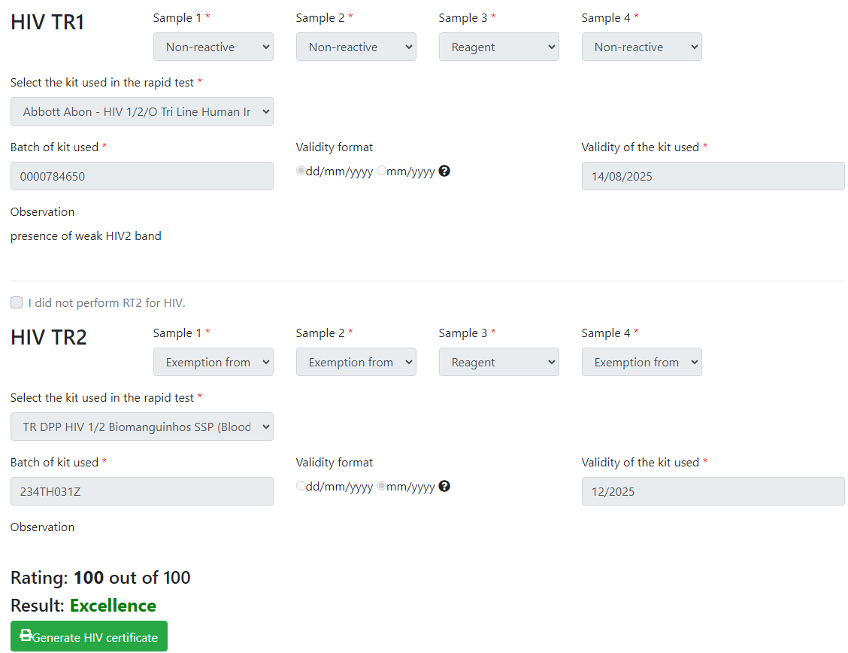
Manage and Use PT data

Slide 6
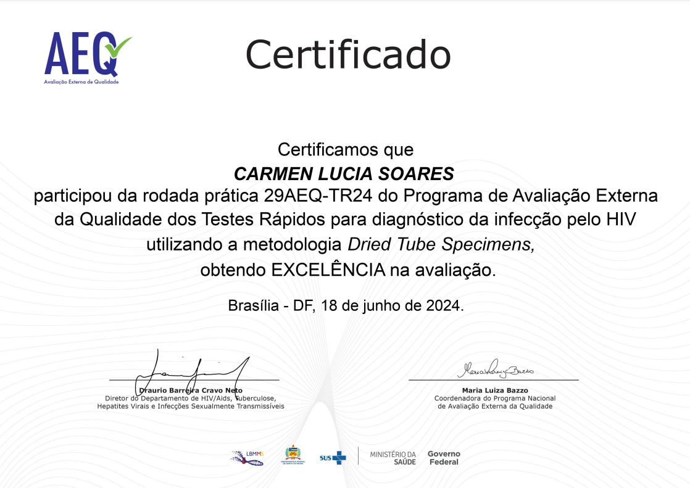
Manage and Use PT data
NOME DO PROFISSIONAL

Slide 7
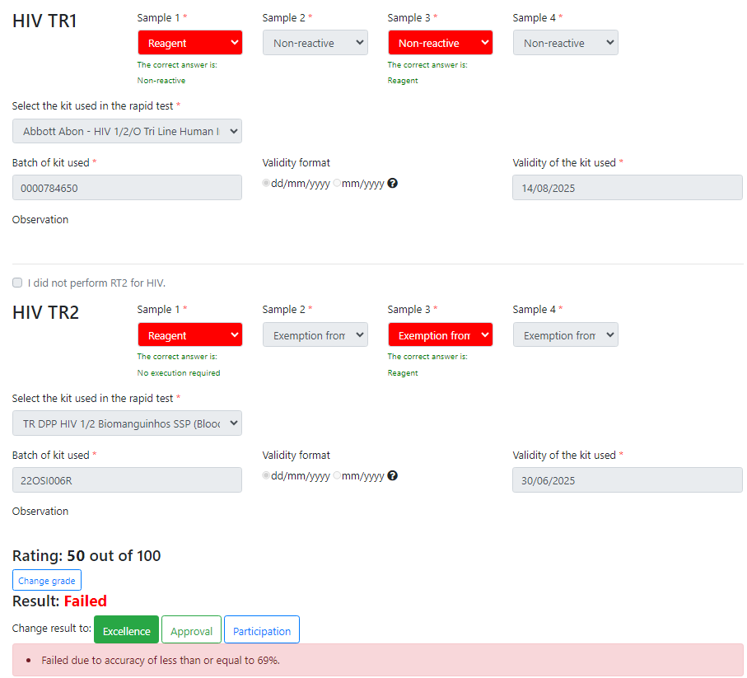

Slide 8
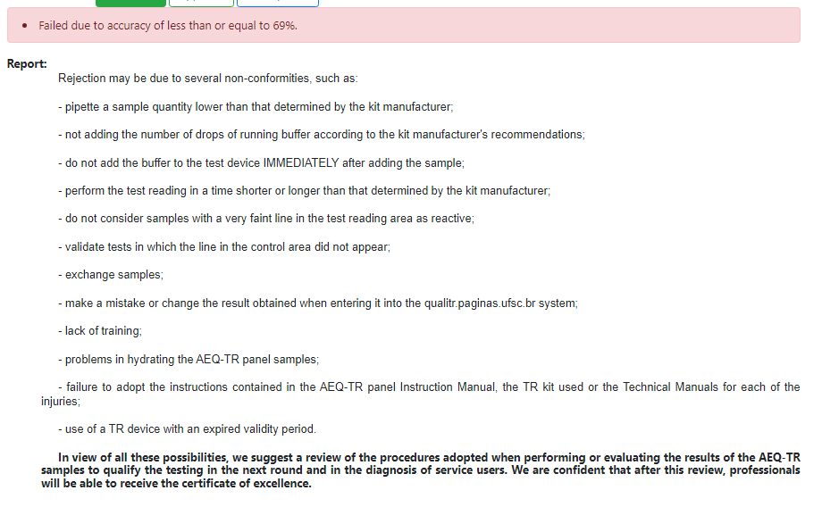
Unit coordinator:
monitor the results of participants in your unit
monitor execution when the professional fails
offer theoretical and practical training

Slide 9
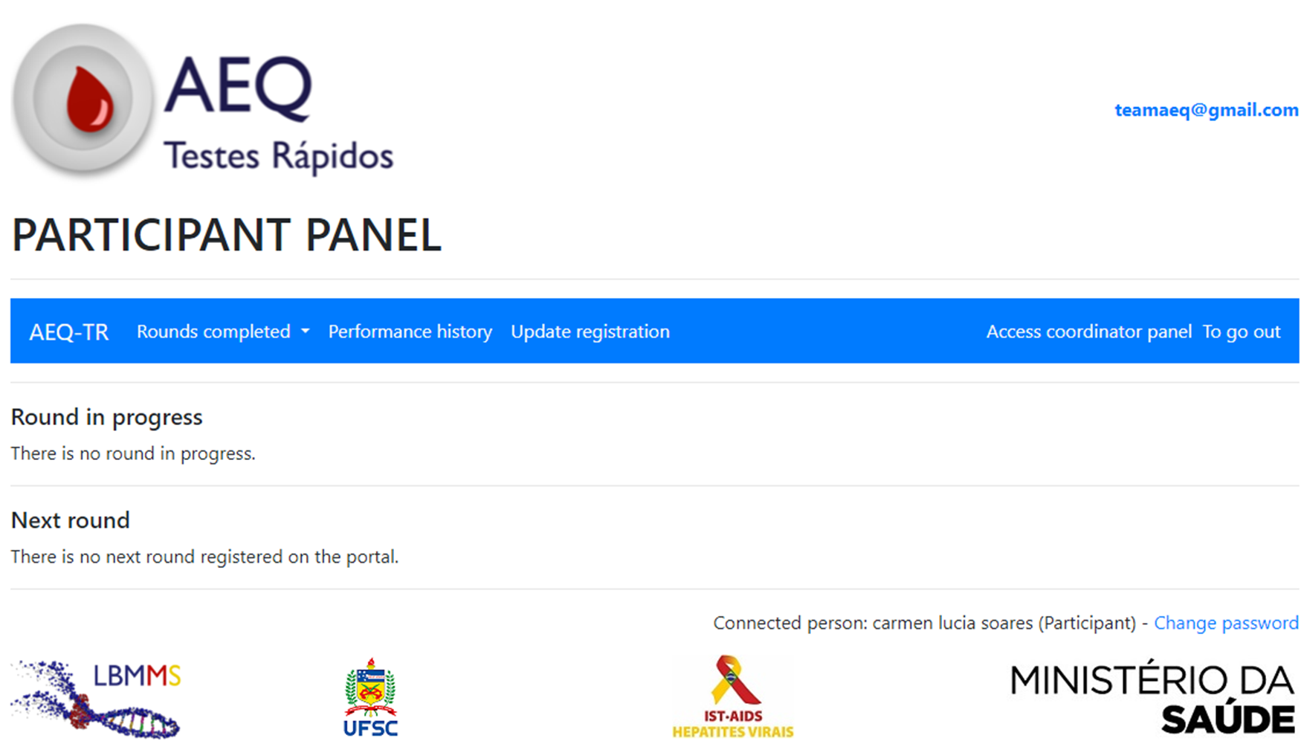
Manage and Use PT data
Name

Slide 10
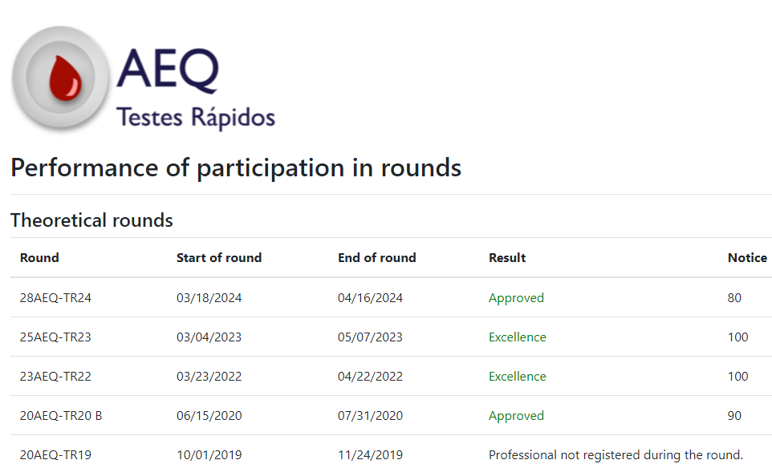
Manage and Use PT data

Slide 11
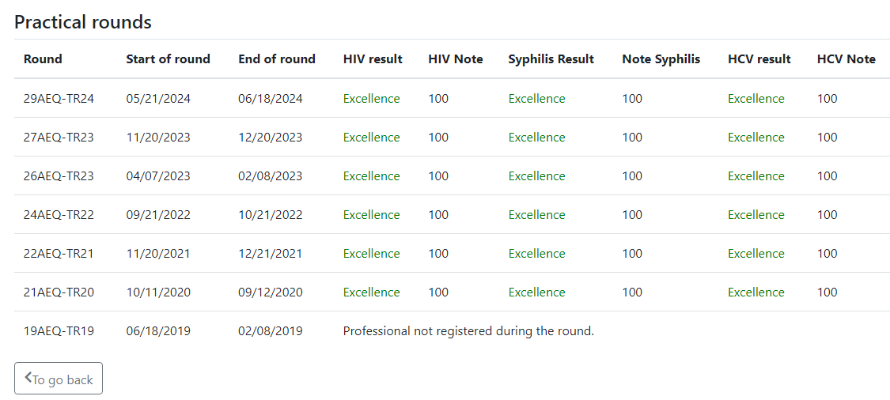
Manage and Use PT data

Slide 12

Manage and Use PT data
Name

Slide 13
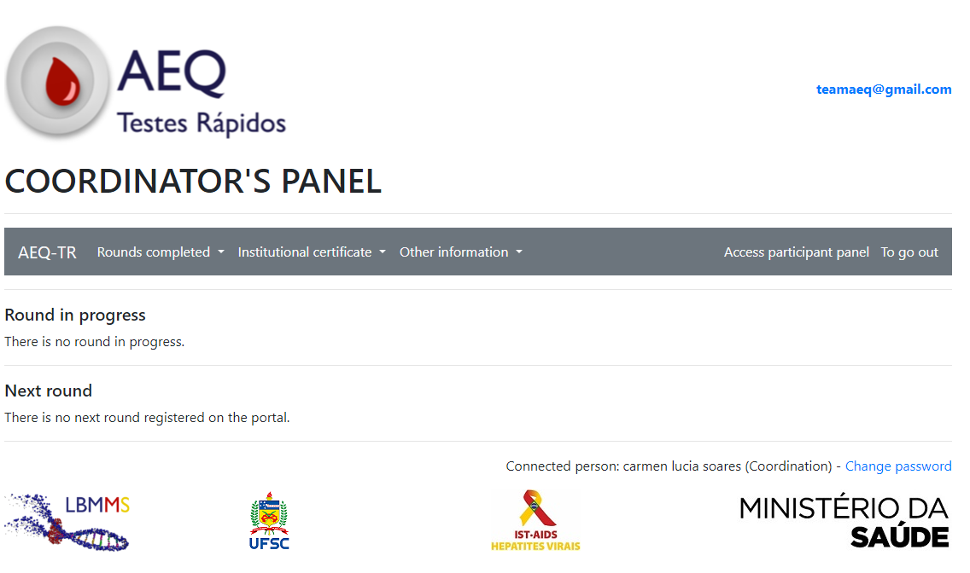
Manage and Use PT data

Slide 14
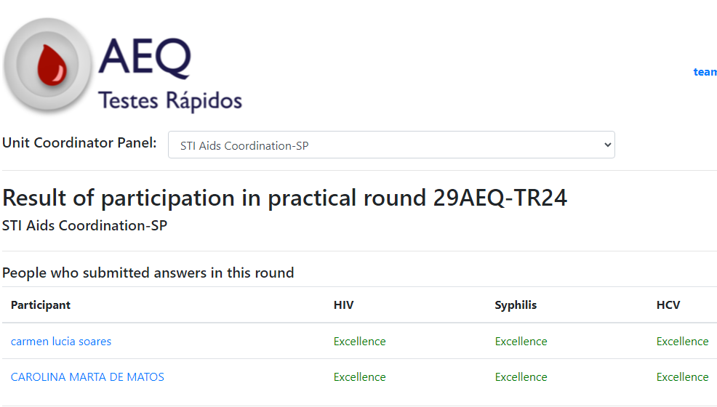
Manage and Use PT data
Name
Name

Slide 15
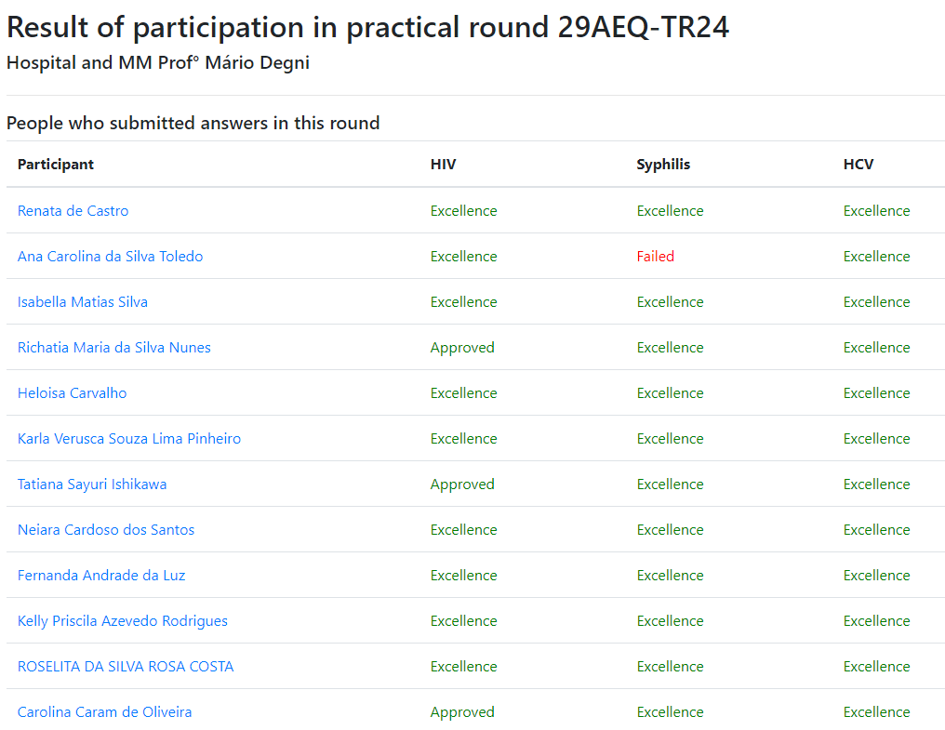
Name 1
Name 2
Name 3
Name 4
Name 5
Name 6
Name 7
Name 8
Name 9
Name 10
Name 11
Name 12

Slide 16
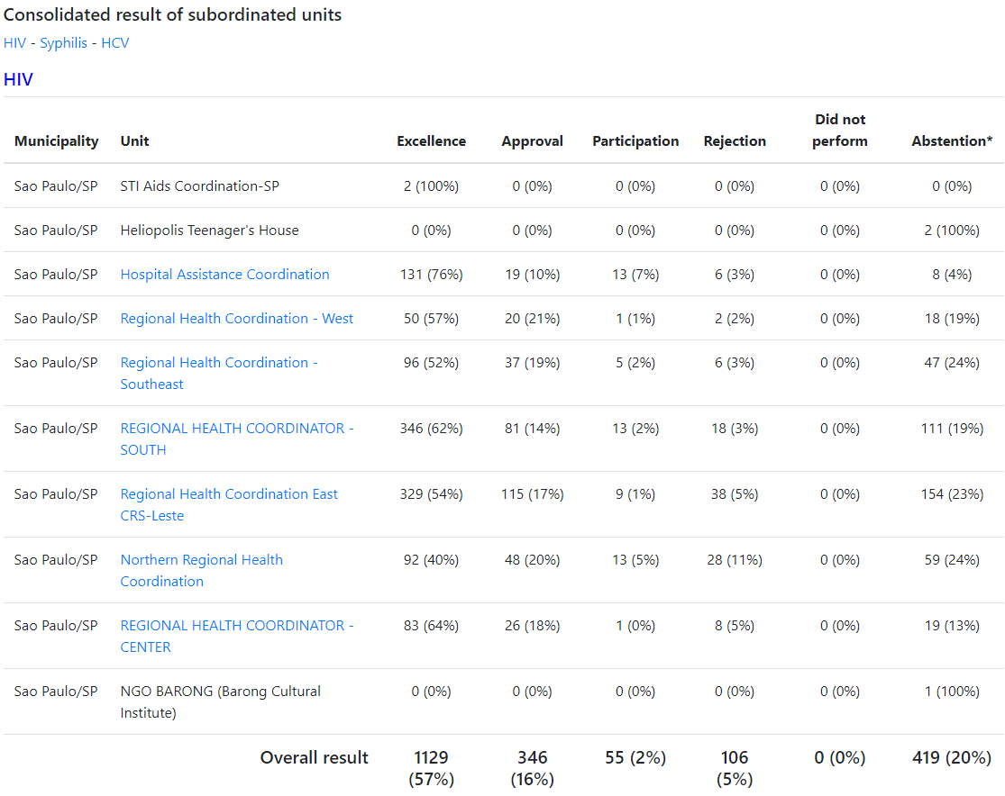
Manage and Use PT data

Slide 17
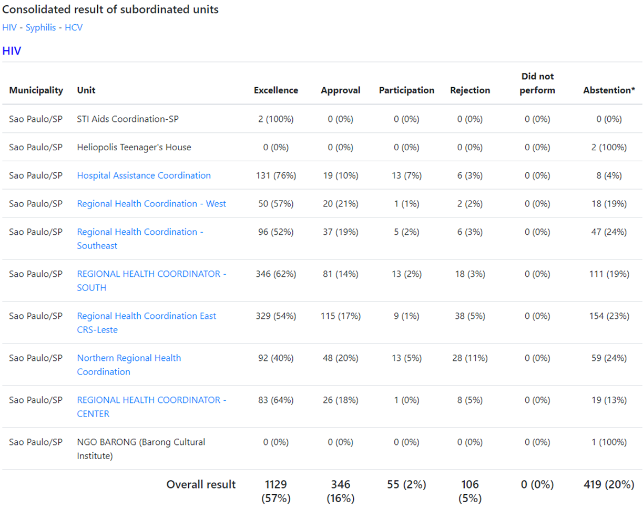
Manage and Use PT data

Slide 18
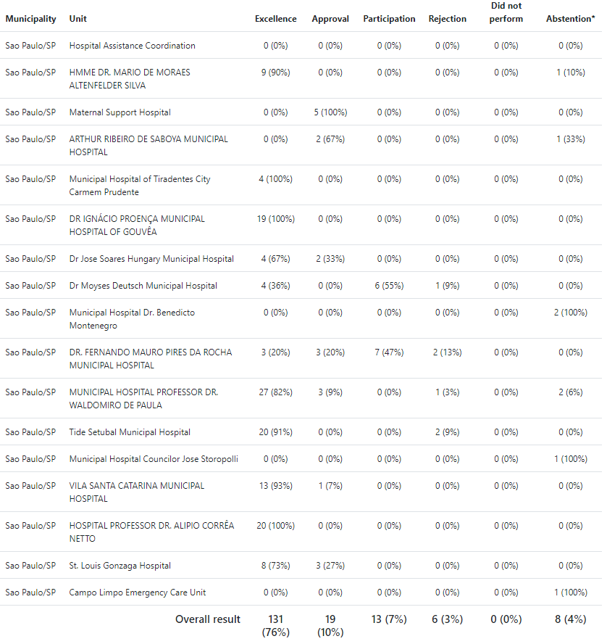
Manage and Use PT data

Slide 19
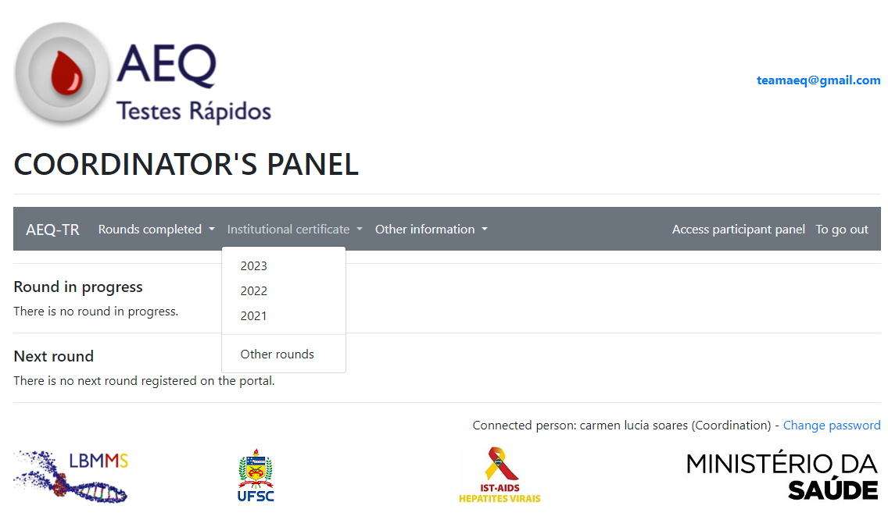
Manage and Use PT data

Slide 20
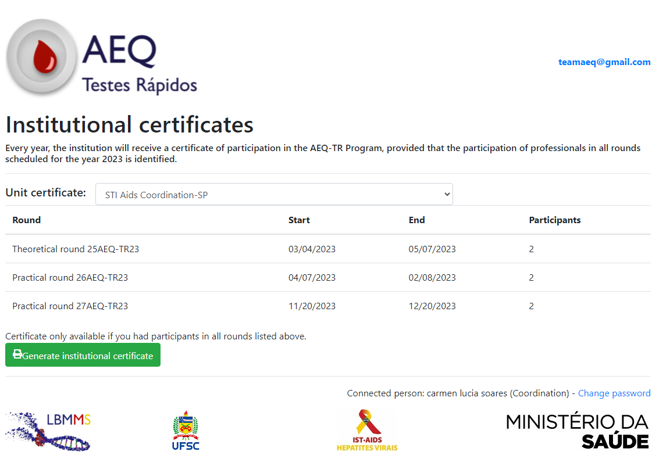
Manage and Use PT data

Slide 21
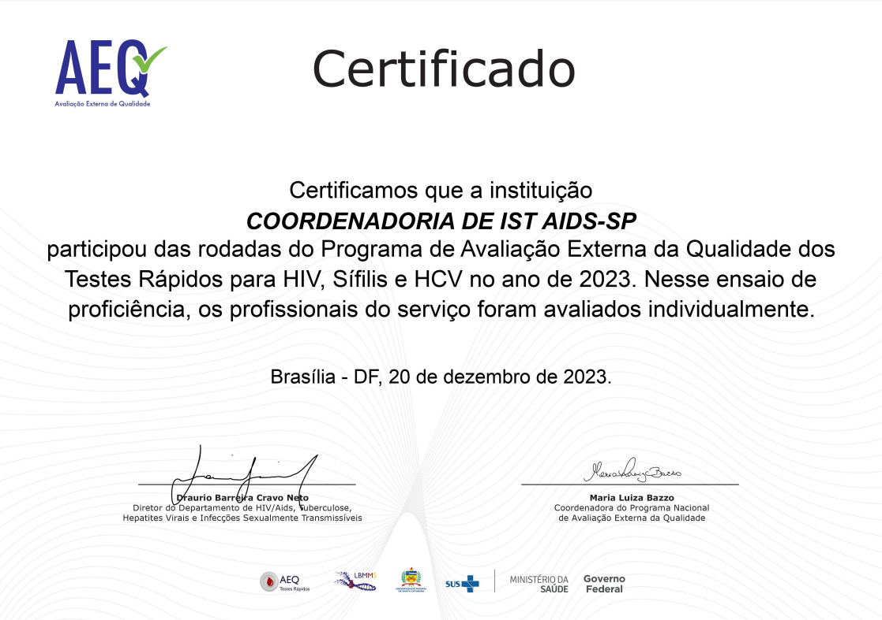
Manage and Use PT data

Slide 22
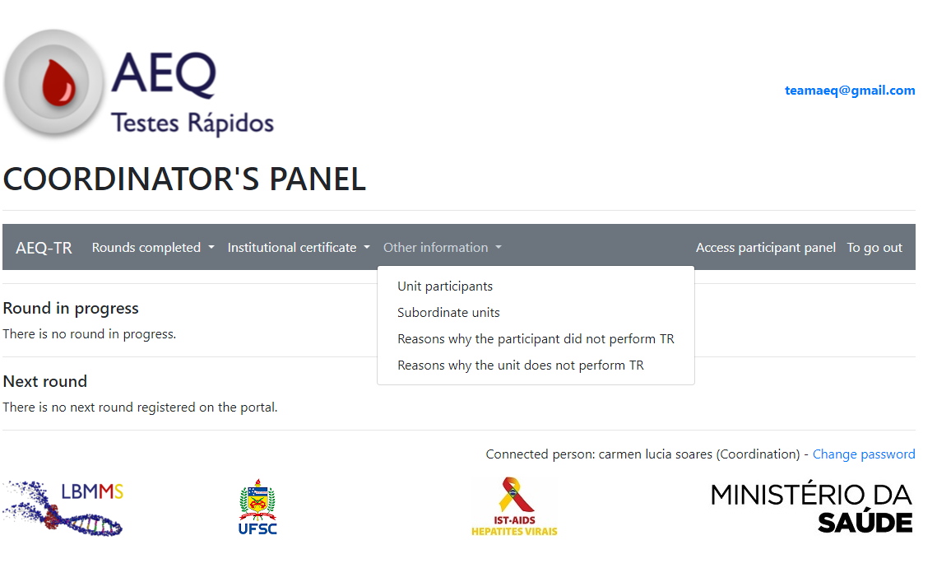
Manage and Use PT data

Slide 23
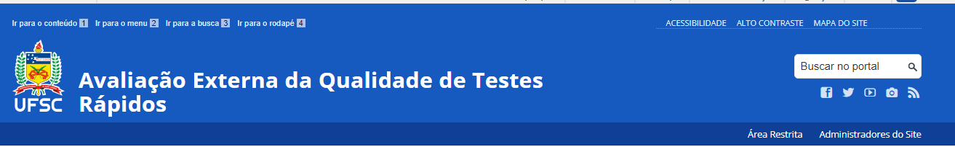
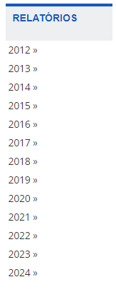

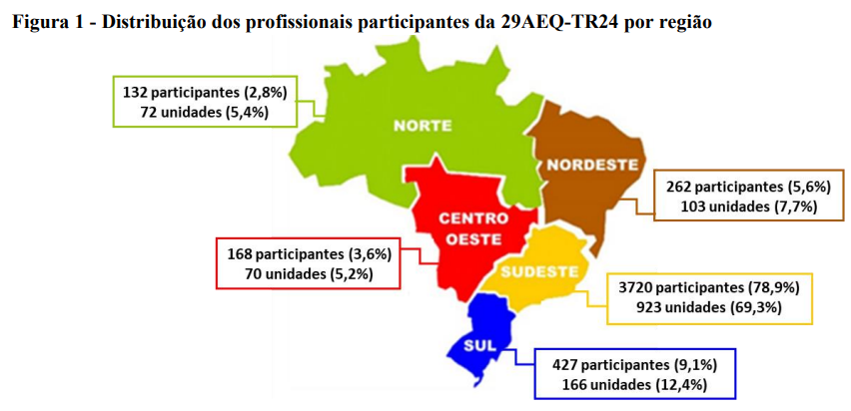
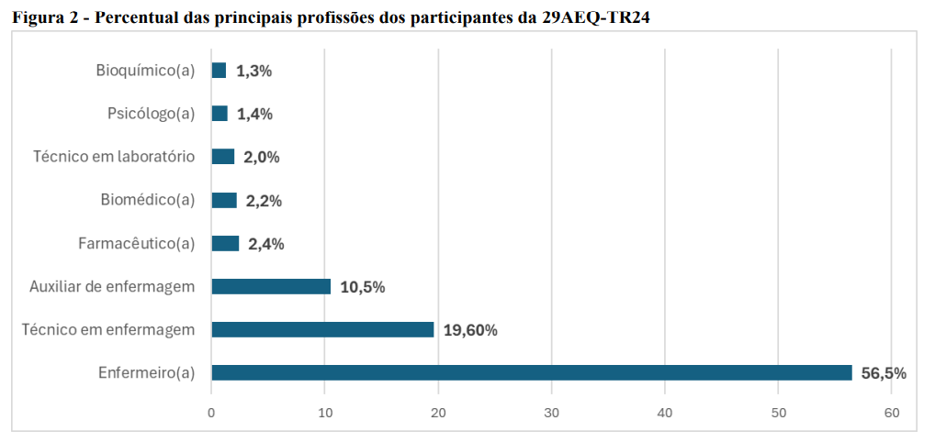

Slide 24
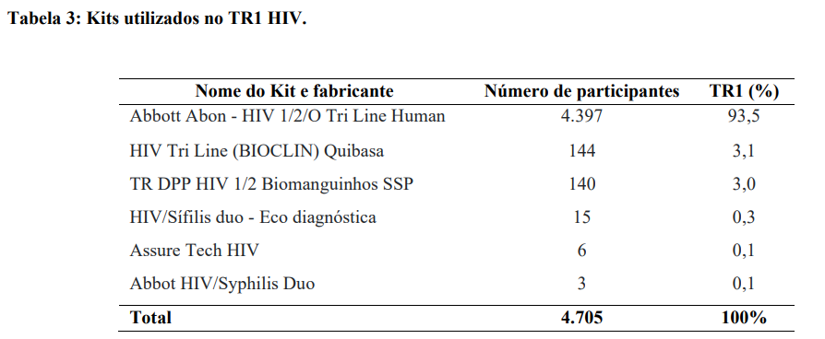
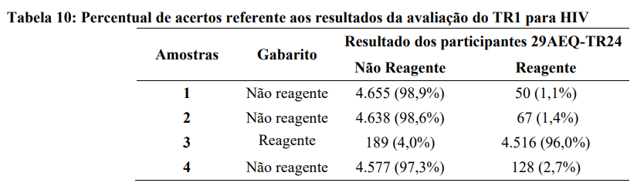
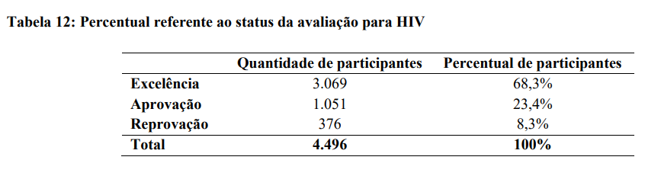
Ministry of Health receives the data from each round;
Programs improvements in guidelines for health services;
Sends a summary of the main highlights of each round to state and capital managers.

Slide 25
aeq@aids.gov.br

